Slide 1





GROUP 5
Brand Introduction
Buyer Analysis
Conclusion
GET STARTED >>

Slide 2

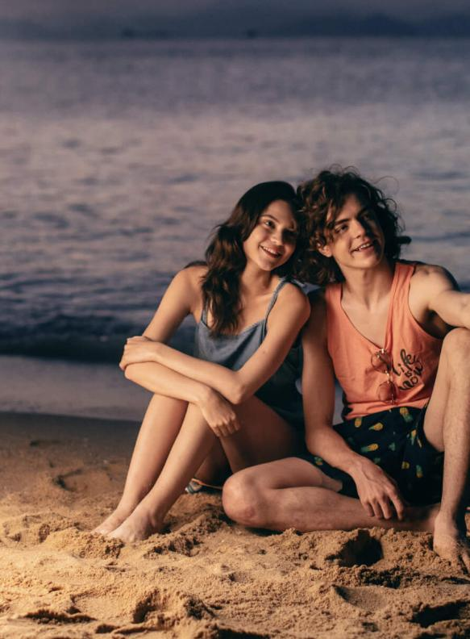
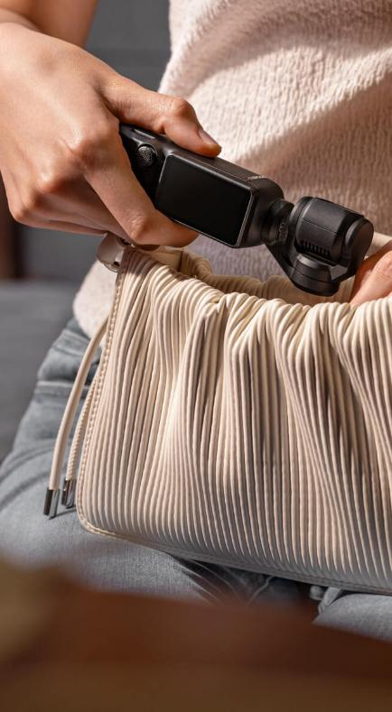
GROUP 5
Brand Introduction
Buyer Analysis
Conclusion
GET STARTED >>
Brand Introduction
Buyer Analysis
Conclusion

Slide 3
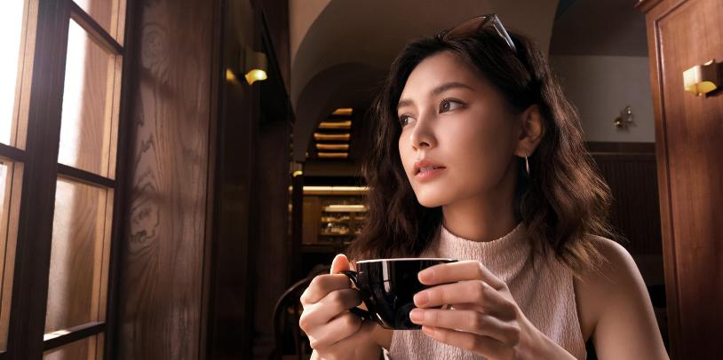


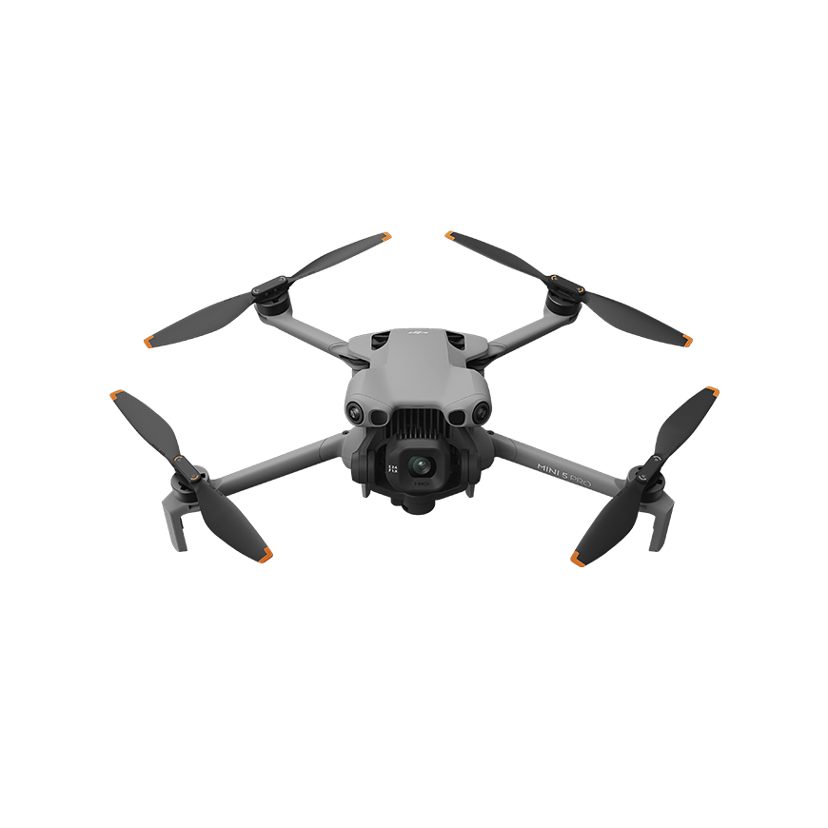
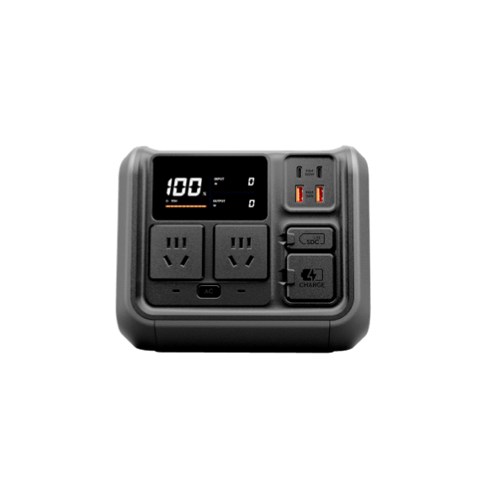
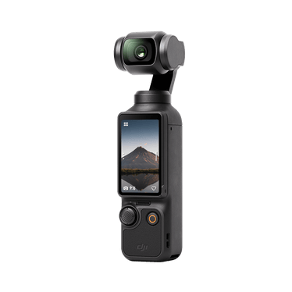
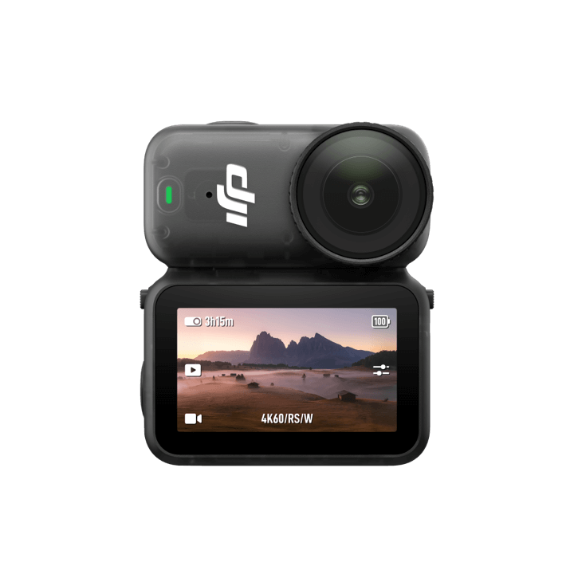

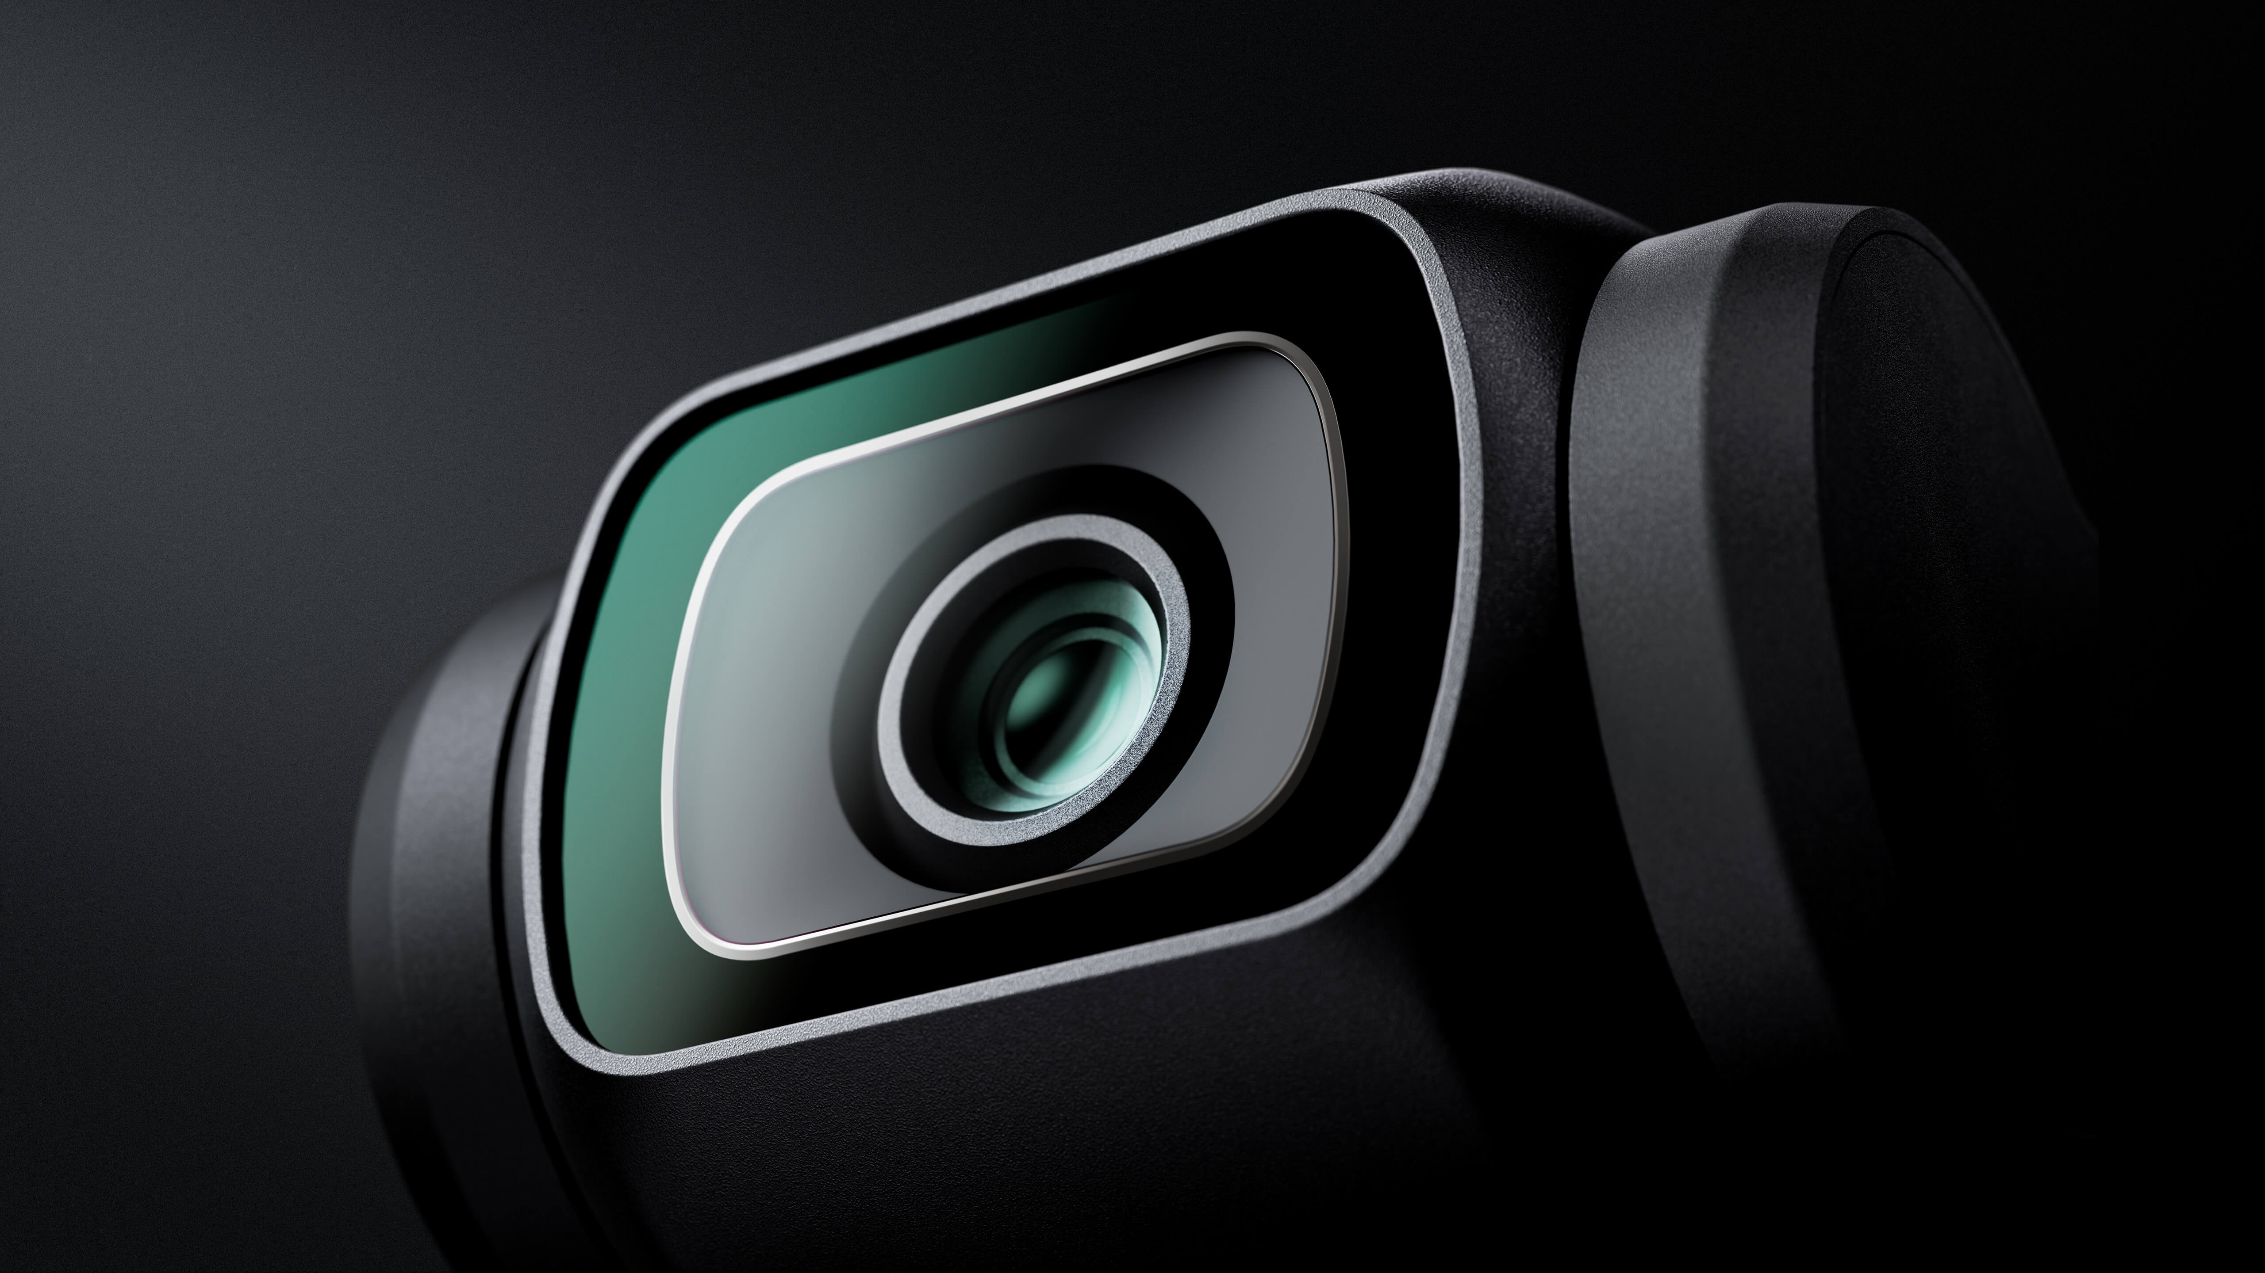

GROUP 5
Brand Introduction
Buyer Analysis
Conclusion
Location: Shenzhen, China
Founded: 2006
Idea:”未来无不可”(The future of possible)
Brand Introduction
Notes:
品牌名称：DJI Technology Co., Ltd.
品牌简介：DJI is a privately owned Chinese company headquartered in Shenzhen, specializing in civilian drones, creative camera technology, and related accessories for aerial photography, filmmaking, and other applications. Founded in 2006 by Frank Wang Tao, DJI has grown into the global leader in its field, with a focus on innovative products for consumer, professional, agricultural, and commercial uses.
品牌理念："未来无所不可"(The Future of Possible)
主要产品：
航拍无人机( Camera Drones )
DJI Mavic 3 Classic
DJI Mavic 3
Mavic 2
Mavic Pro
Mavic Pro Platinum
手持摄影装置( Handheld )
Osmo Action Series
Osmo 360 Series
Osmo Nano Series
Osmo Pocket Series
Osmo Mobile Series
DJI Mic Series
Ronin Camera
Ronin Stabilizer
户外电源( Power )
DJI Power Series

Slide 4
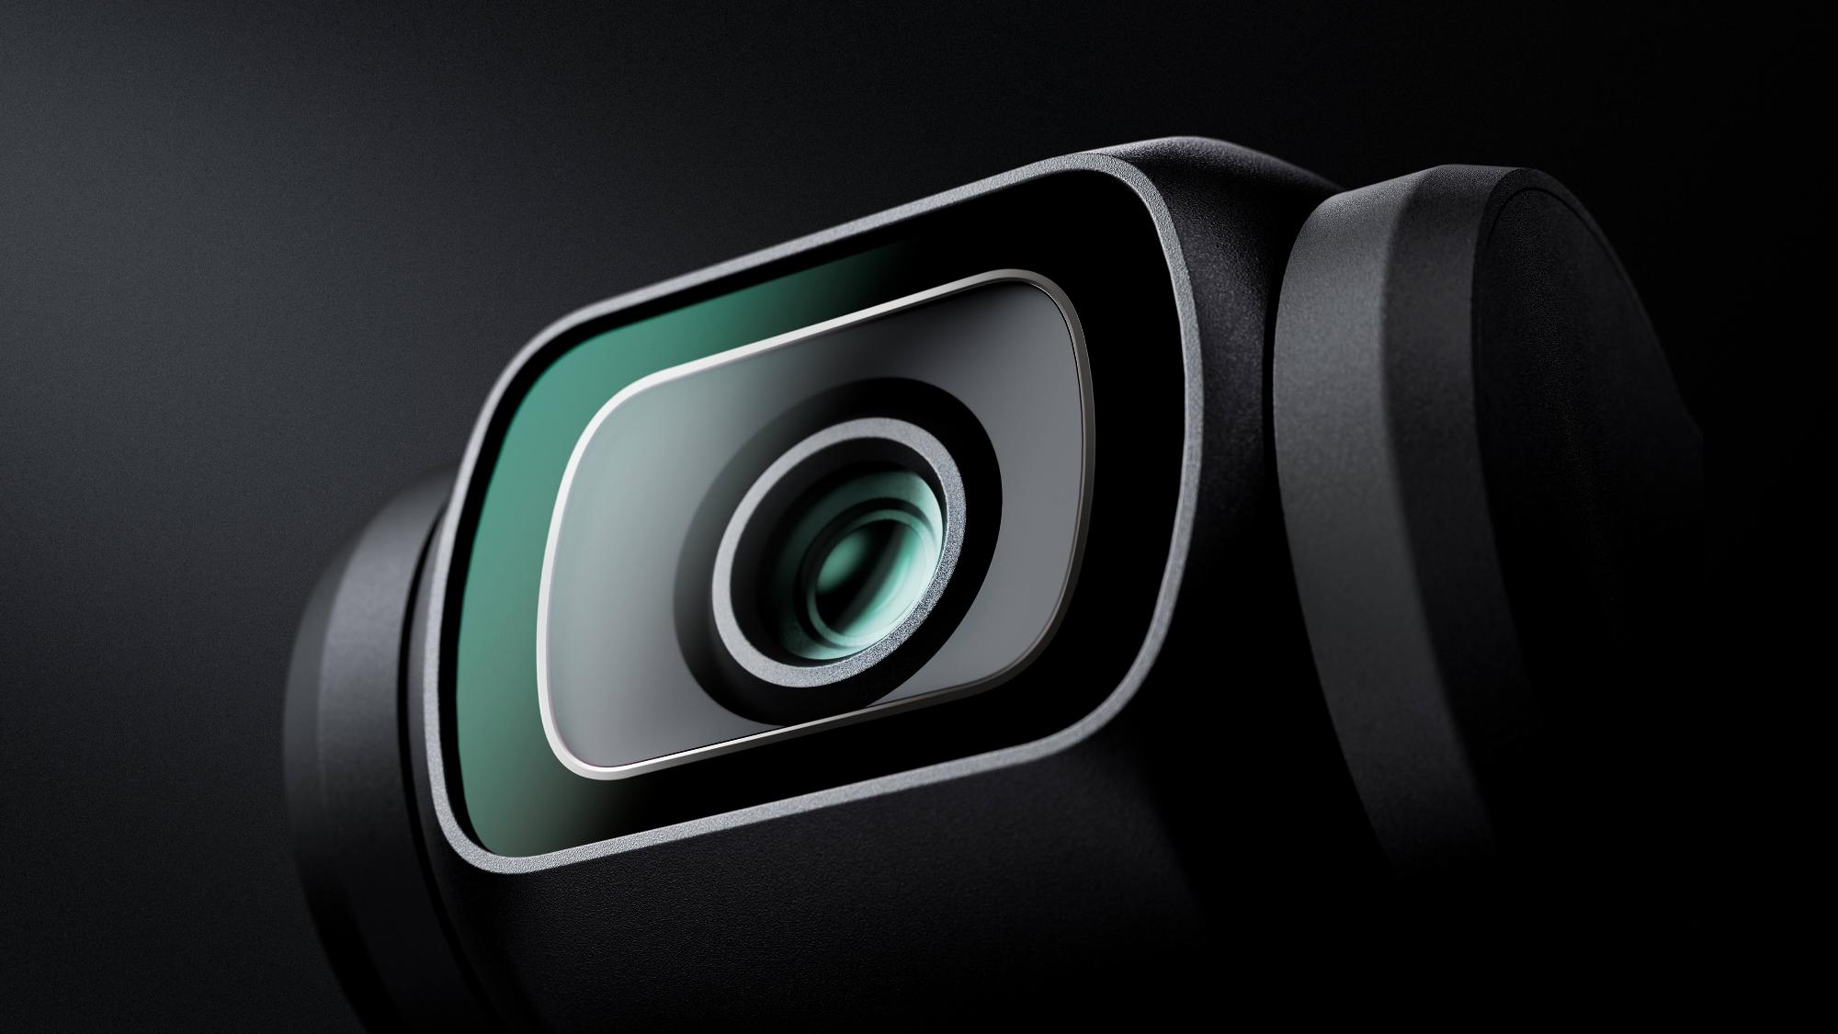
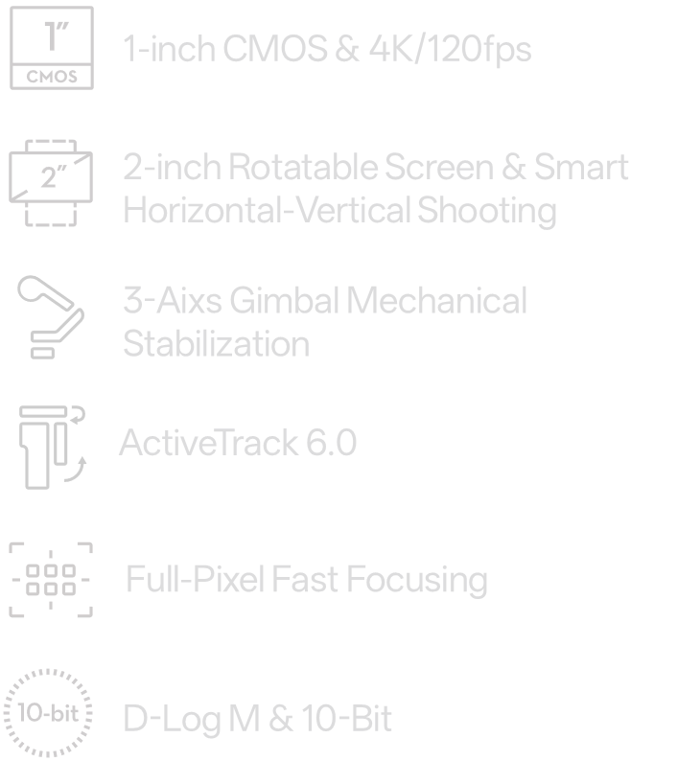

GROUP 5
Brand Introduction
Buyer Analysis
Conclusion
Product
Notes:
产品定位：A highly portable, high-quality shooting device for lightweight content creators
产品特点：Portable anti-shake, 4K shooting, intelligent following, AI theme generation, focusing on vlogging, traveling, daily recording and other scenes
“The all-new Pocket 3 features a powerful 1-inch CMOS sensor that puts detail-rich imaging right in the palm of your hand. With a 2-inch rotatable touchscreen and full-pixel fast focusing, go horizontal or vertical for more precise awareness and control. 4K/120fps, three-axis mechanical stabilization, and a host of intelligent features make Pocket 3 ready for any moving moment.”

Slide 5






GROUP 5
Brand Introduction
Buyer Analysis
Conclusion
Core Selling Points
Of DJI OSMO Pocket 3
Notes:
主要卖点：1.High-quality video and sound
Portable
Easy to use
Fast charging, Long lasting
Glamour effects (Optional)

Slide 6
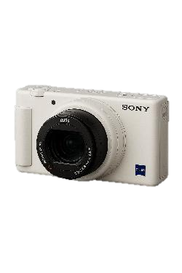
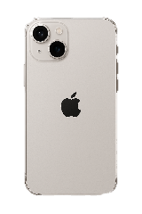
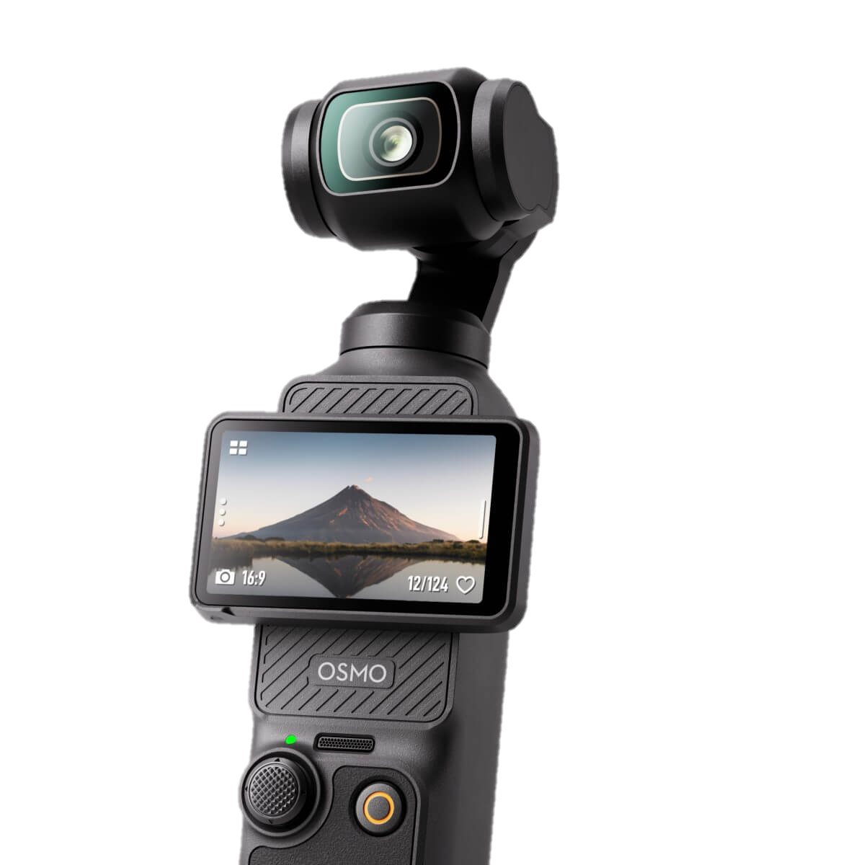
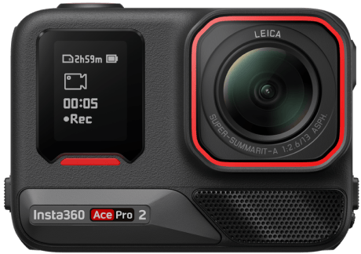
GROUP 5
Brand Introduction
Buyer Analysis
Conclusion
Main Competitors
iPhone Shooting Features
02
01
Sony ZV-1
03
04
Insta360 Series
ETC.
?
Notes:
主要竞品：iPhone Shooting Features, Sony ZV-1, Insta360 Series, etc.

Slide 7


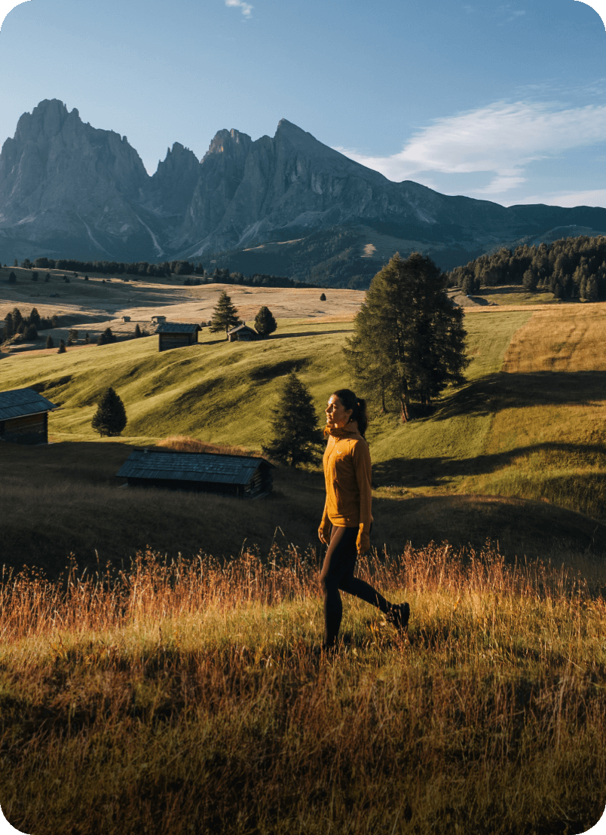
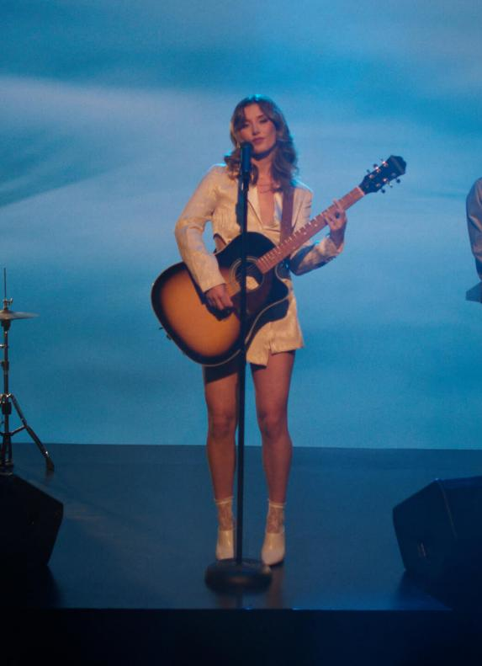
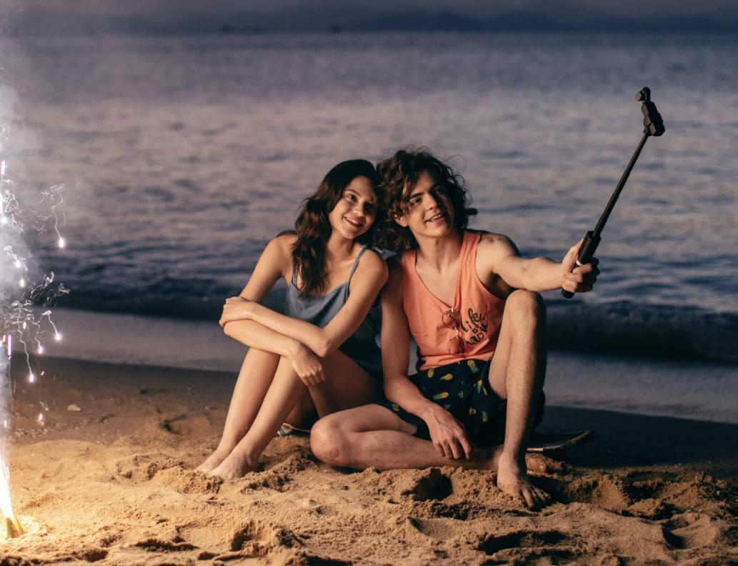
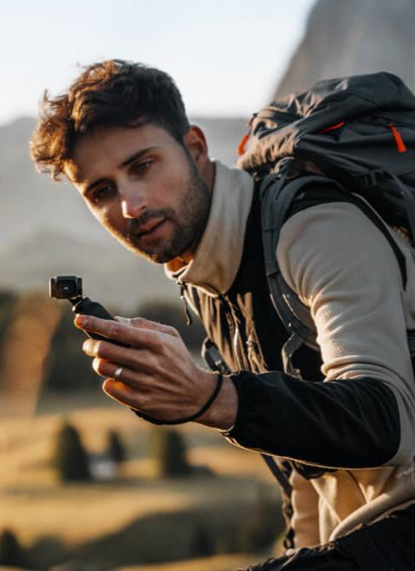
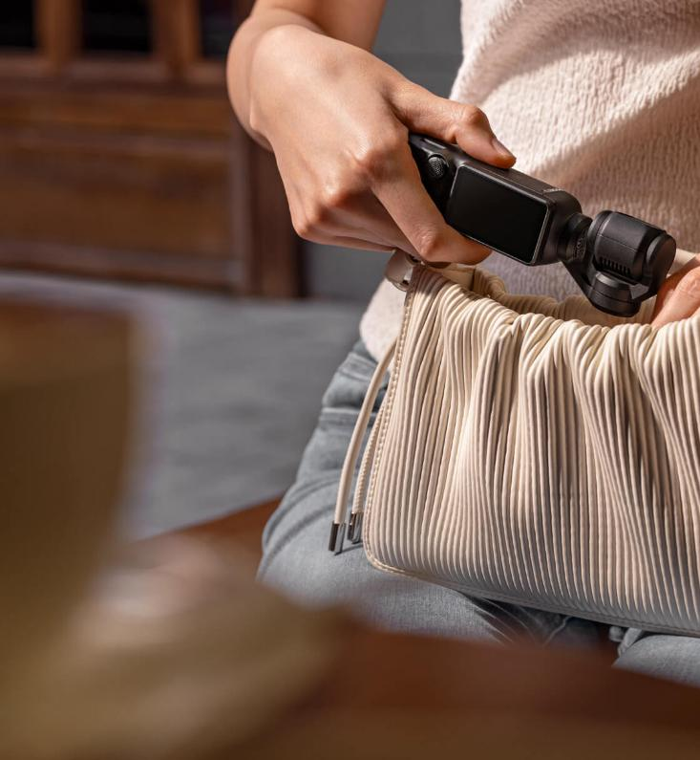
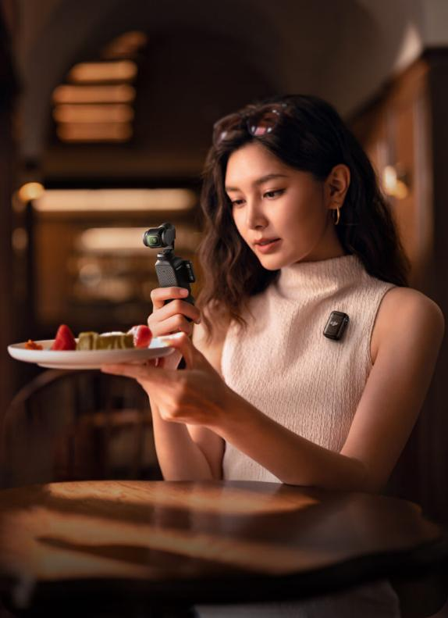

GROUP 5
Brand Introduction
Buyer Analysis
Conclusion
NEXT PART >>
Buyer Analysis
WHERE
WHAT
WHEN
HOW
WHY
WHO
Brand Introduction
Conclusion

Slide 8

GROUP 5
Brand Introduction
Buyer Analysis
Conclusion
WHERE
WHEN
WHY
HOW
Buyer Analysis
WHO

Slide 9
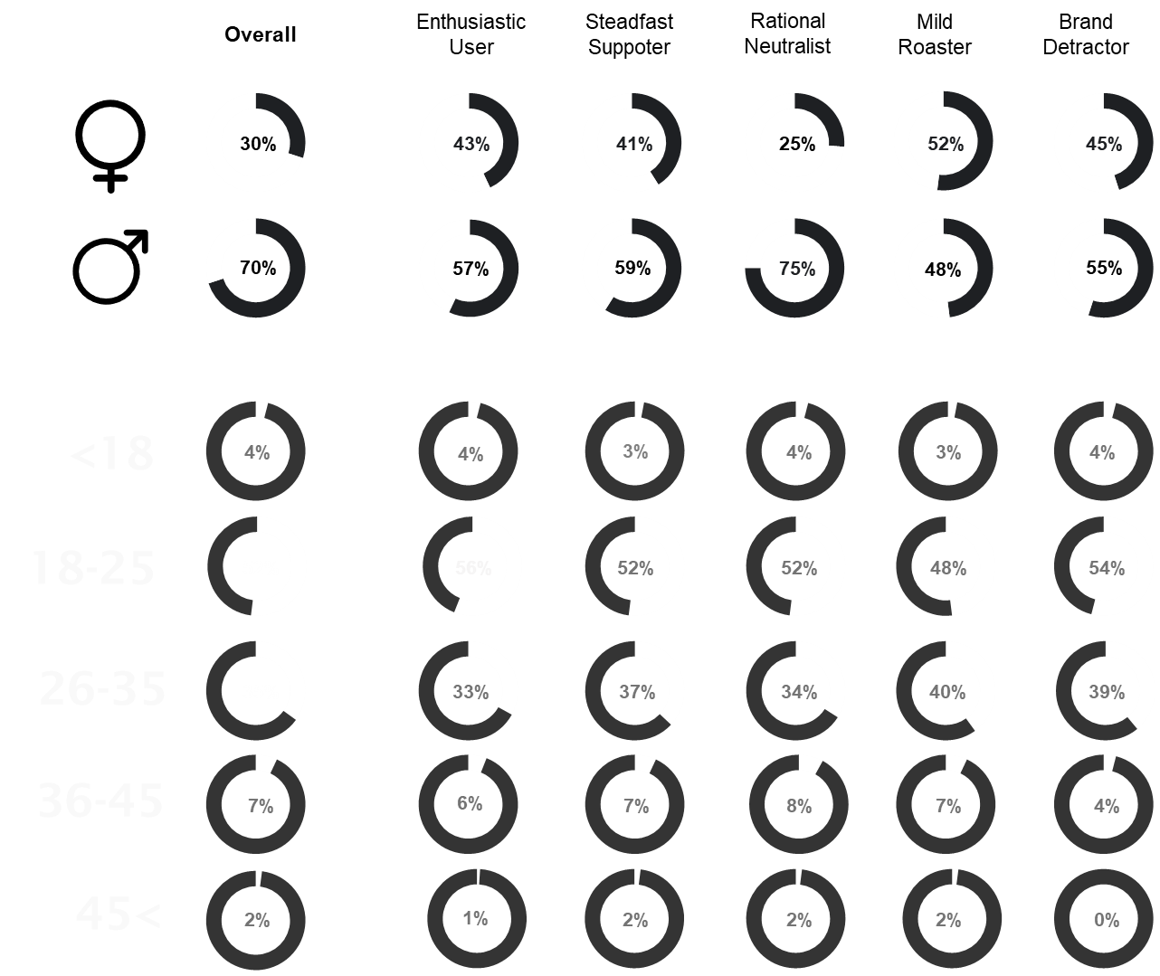
GROUP 5
WHO
Demographic Characteristics
Notes:
Users aged 18-25 make up the largest group (52%), followed by those aged 26-35 (35%). Among the most passionate fans ('avid supporters'), the 18-25 age group is even larger (56%), showing a clear trend towards a young user base.
Users under 18 and over 45 represent smaller segments (approximately 4% and 2% respectively).

Slide 10
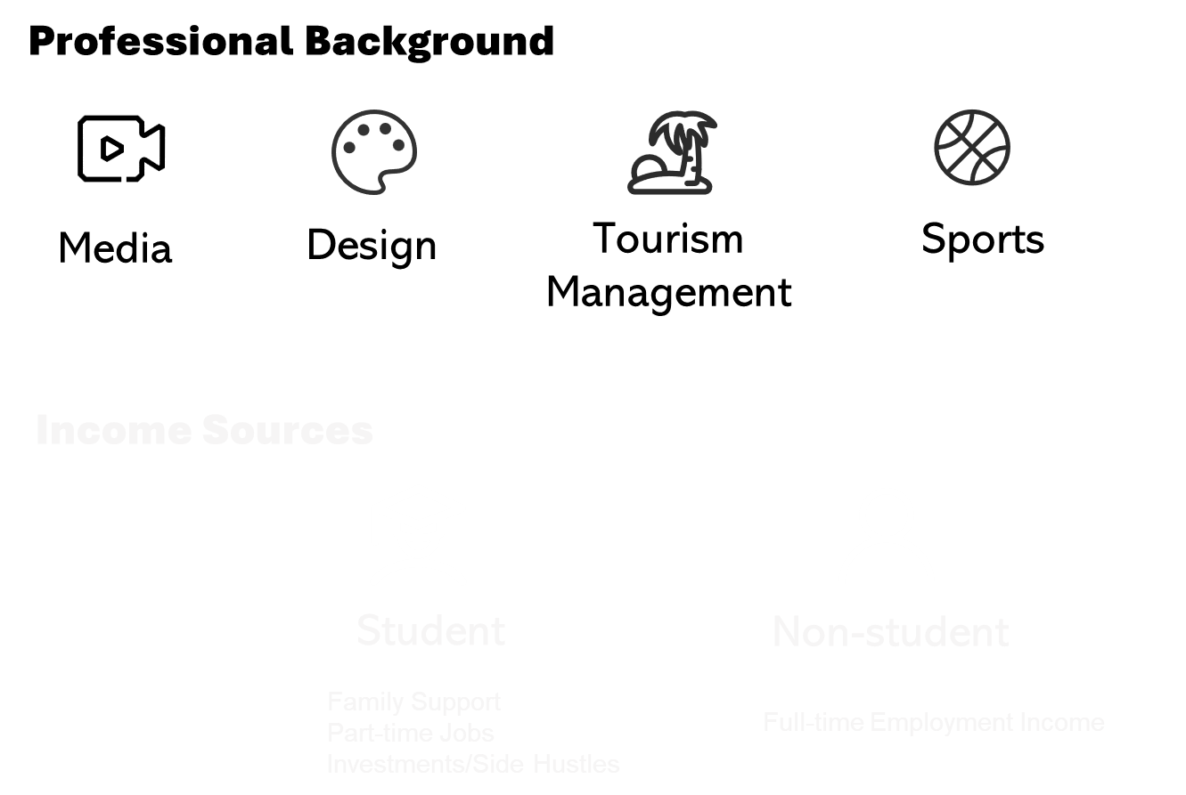
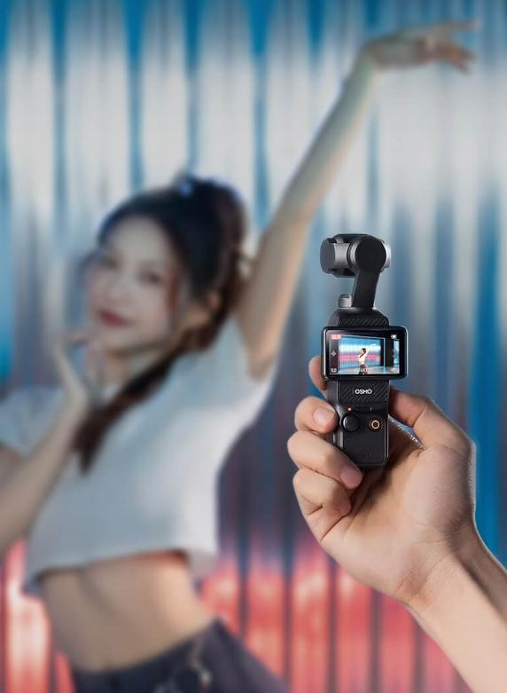
GROUP 5
Brand Introduction
Buyer Analysis
Conclusion
WHO
Demographic Characteristics
Notes:
专业背景Professional Background:：
Users likely come from diverse fields related to content creation and outdoor activities, such as media, design, tourism management, and sports. A campus trends report indicates that students born post-2005 are actively investing in self-improvement (e.g., AI editing, photography, language learning), suggesting heavier usage among majors like new media and arts, which have high demand for digital devices.
收入来源：Income Sources:
Student users primarily rely on family support, part-time jobs, or income from investments/side hustles (e.g., trading, content creation). The campus report notes average monthly disposable income is around ¥2,500 for undergraduates, ¥3,200 for master's students, and ¥4,000 for doctoral students. However, they often supplement this through active earning efforts.
Non-student users likely rely mainly on full-time employment income, though the reports don't detail this segment specifically.

Slide 11
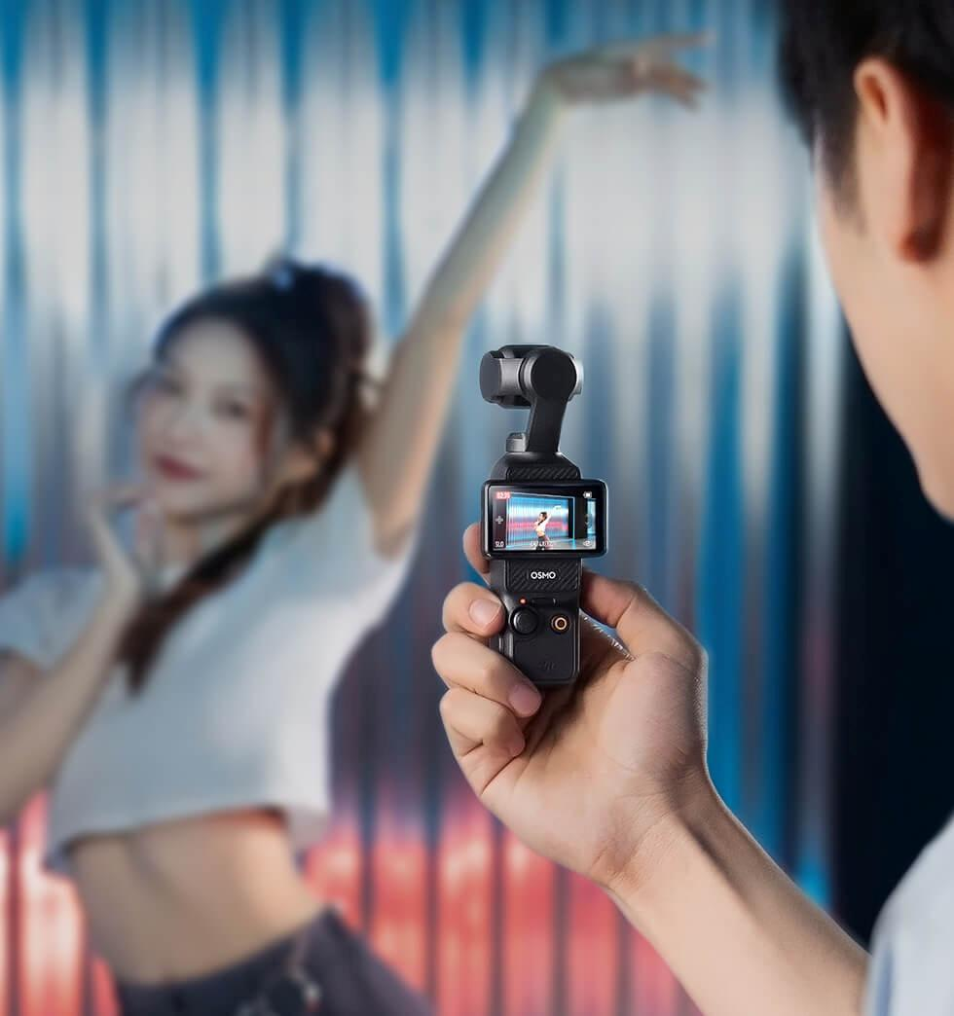
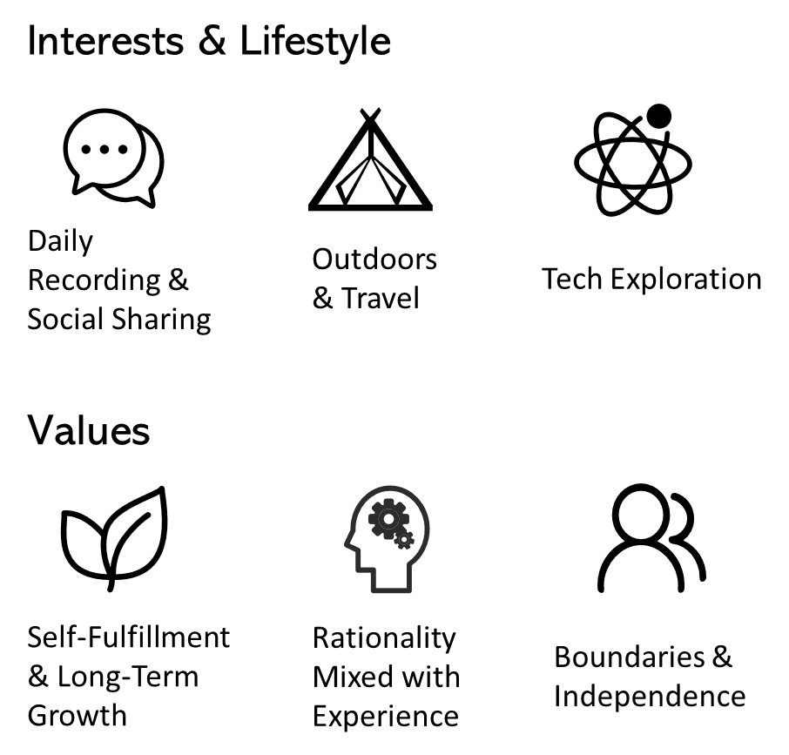
GROUP 5
Brand Introduction
Buyer Analysis
Conclusion
WHO
Psychographic Characteristics
Notes:
心理特征Psychographic Characteristics
- 兴趣与生活方式：Interests & Lifestyle:
Outdoors & Travel: Avid fans prefer activities like cycling (40.97%), traveling (17.11%), fishing, hiking, and trekking. This aligns with the brand's association with a sense of "freedom and vibe."
Daily Recording & Social Sharing: Users treat action cameras as "social currency" for creating daily vlogs, capturing campus life, travel selfies, concerts, etc. The campus report adds that post-2005 students are into "light social relationships" (e.g., 'buddy' culture for specific activities) and use video content to strengthen their social circles.
Tech Exploration: Users pay attention to product features like video clarity, image stabilization, and resolution. They actively use AI tools (e.g., editing software, smart assistants) to aid their creative process.
价值观：Values
Self-Fulfillment & Long-Term Growth: They value internal motivation (passion + potential + growth) and pursue "meaningful change." For example, content from supporters often highlights themes like "healing," "cinematic feel," and "sense of freedom."
Rationality Mixed with Experience: While they focus on value-for-money when spending, they are also willing to pay for emotional experiences (e.g., concerts, travel). They generally avoid overspending, preferring "smart spending" and "investment-type consumption" (e.g., buying digital gear for self-improvement).
Boundaries & Independence: They emphasize personal space, driving demand for services/products facilitating solitude (e.g., bed curtains, projectors for dorms). This desire for individuality is also reflected in their pursuit of personalized expression through video creation.

Slide 12
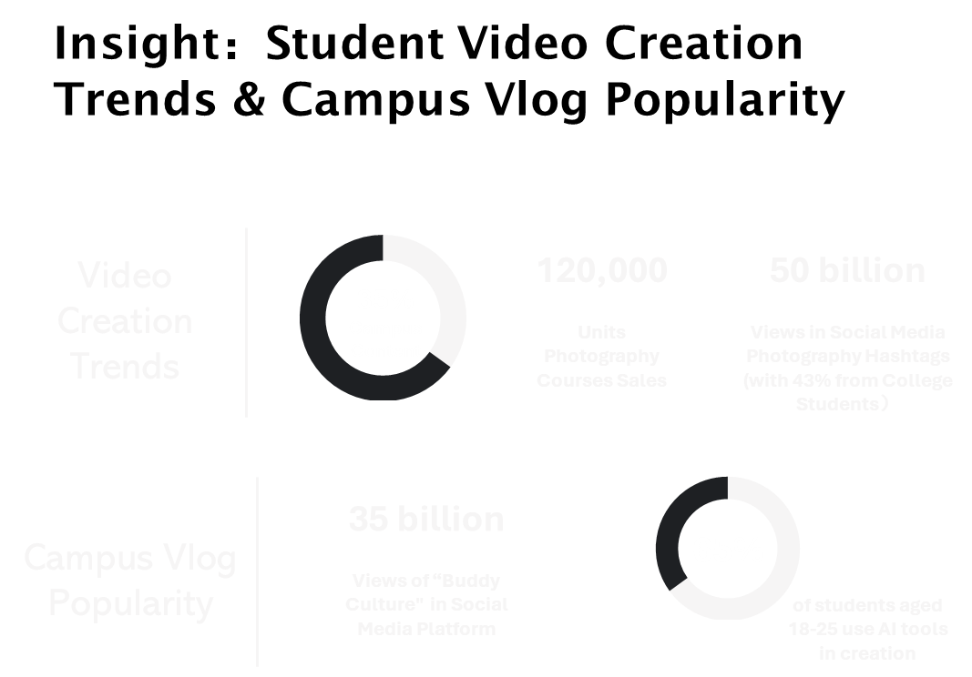
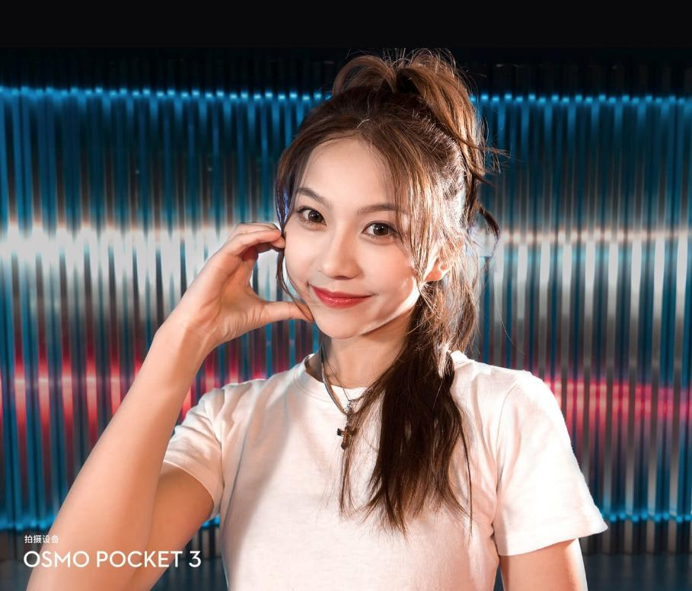
GROUP 5
Brand Introduction
Buyer Analysis
Conclusion
WHO
Notes:
Insights：学生视频创作趋势与校园vlog流行度
Among action camera users, campus-related content accounts for 35% of interactions, indicating students are a core creator group. The main themes are scenery (66.52%), portraits/group photos (13.81%), and animals/pets (7.68%), which fits the "daily life recording" nature of campus vlogs. The campus report notes strong sales of photography courses (120,000 units), social media photography hashtags exceeding 50 billion views (with 43% from college students)
The report mentions "buddy culture" (e.g., study buddies, meal buddies) has over 3.5 billion views, driving lightweight video creation. Data shows that 65% of students aged 18-25 use AI tools in their creation process, further lowering the barrier to vlog production and increasing the appeal of devices like the DJI Pocket 3.

Slide 13
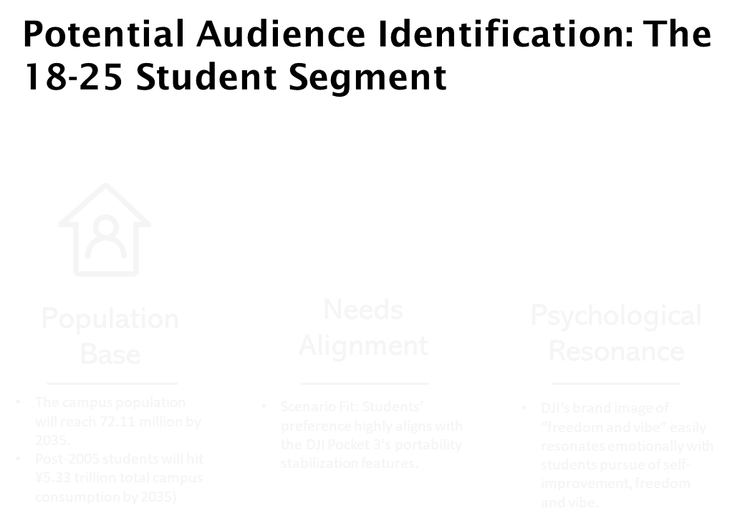
GROUP 5
Brand Introduction
Buyer Analysis
Conclusion
WHO
Notes:
The 18-25 student group is already a core user base for the DJI Pocket 3 but still holds untapped potential:
Population Base: The campus population is steadily growing, projected to reach 72.11 million by 2035. Post-2005 students have strong spending power (total campus consumption expected to hit ¥5.33 trillion by 2035).
Needs Alignment:
Scenario Fit: Students prefer recording daily life (campus, travel, city walks), which highly aligns with the DJI Pocket 3's portability and stabilization features. Data shows campus scenes account for 7.65% and travel for 17.11% of usage among avid fans.
Psychological Resonance: Students pursue "self-improvement" and use vlogs as "social currency" to build their personal brand. DJI's brand image of "freedom and vibe" easily resonates emotionally with them.

Slide 14
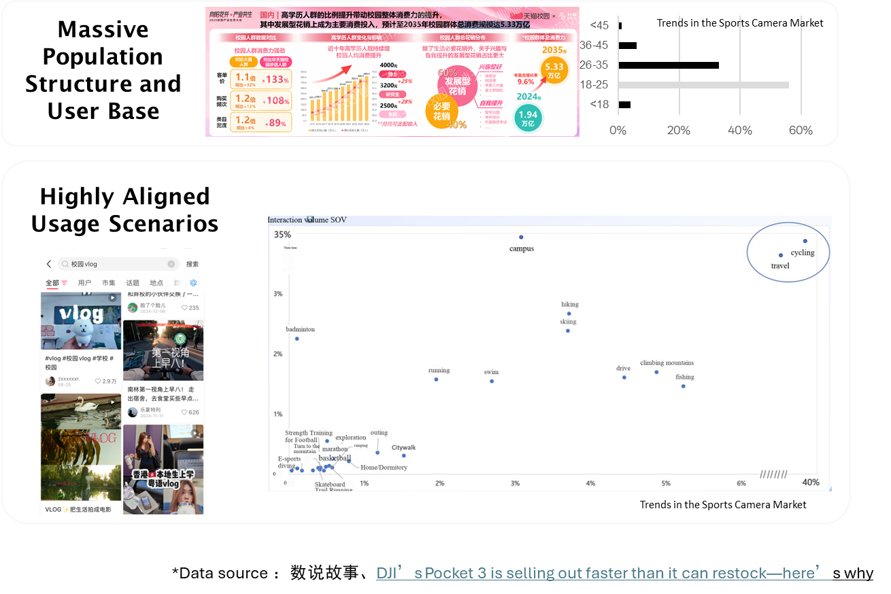
GROUP 5
Brand Introduction
Buyer Analysis
Conclusion
WHY
Notes:
I. Massive Population Structure and User Base
1. Strong Macro-Level Consumption Foundation Among Campus Populations
2. DJI's consumer base shows a high proportion of users aged 18-25
II. Highly Aligned Usage Scenarios
Lifestyle Documentation Scenarios
Travel Scenarios

Slide 15
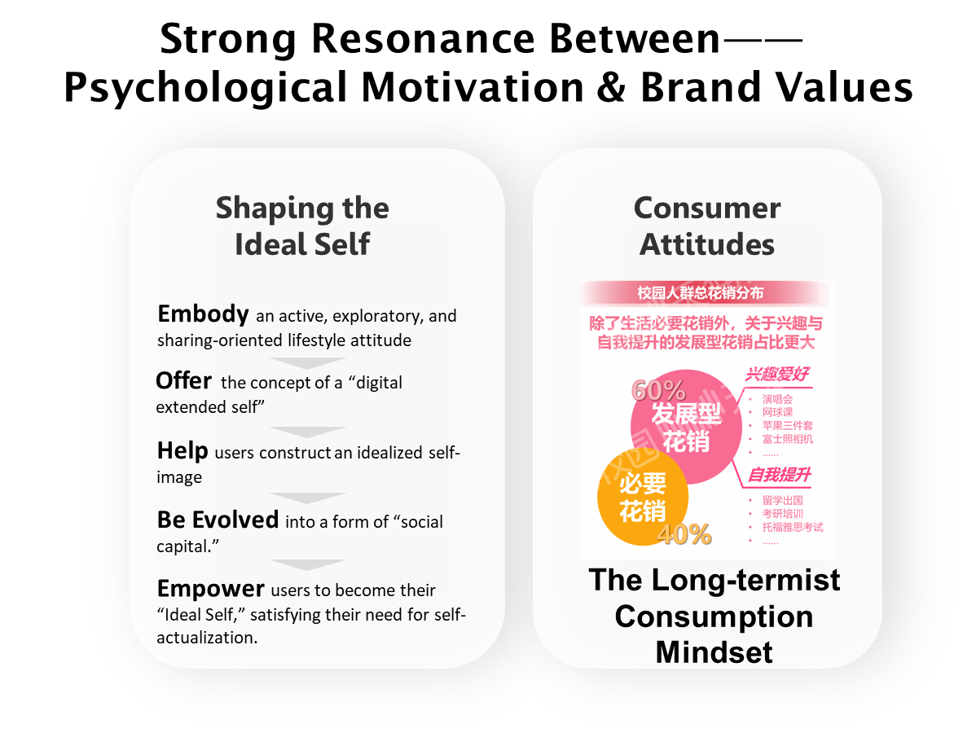

GROUP 5
GROUP 5
Brand Introduction
Buyer Analysis
Conclusion
Notes:
1. Shaping the Ideal Self
The use of action cameras embodies an active, exploratory, and sharing-oriented lifestyle attitude that aligns strongly with the values of the new generation of consumers.
DJI's action cameras offer the concept of a “digital extended self,” aiming to help users construct an idealized self-image—one that excels at photography, embraces life, and loves creation.
Today, DJI action cameras have evolved into a form of “social capital.” Starting as a single device, they have transformed into products that earn recognition from certain groups. This social capital fulfills students' psychological need for self-worth construction, aligning with Maslow's Hierarchy of Needs. It empowers them to become their “Ideal Self,” satisfying their need for self-actualization.
2. Consumer Attitudes
Data on consumption attitudes also reveals that for digital products—items with higher price points and fewer daily use cases—students exhibit a long-termist consumption mindset. This means they prioritize satisfying immediate emotional needs through advance consumption. (Tmall Campus) This further demonstrates that products like the DJI Pocket 3 must fulfill students' present emotional value while simultaneously proving their long-term worth through robust performance. This dual approach persuades students to make more enduring consumption

Slide 16

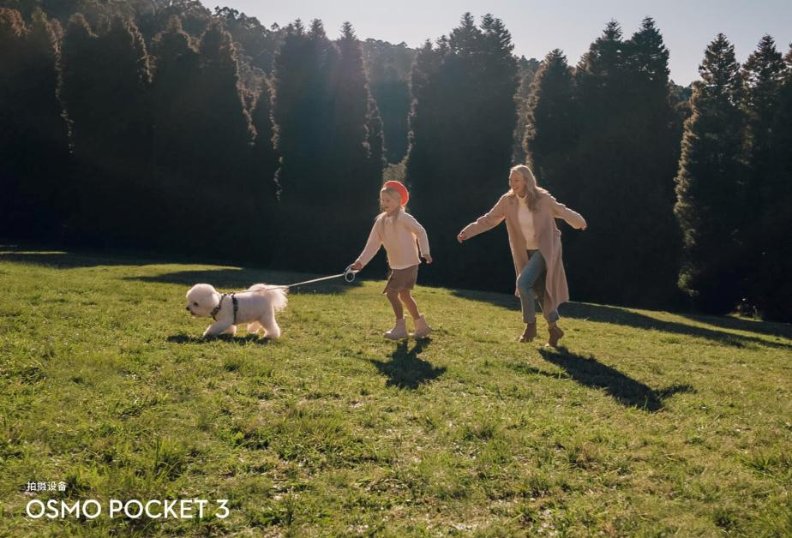
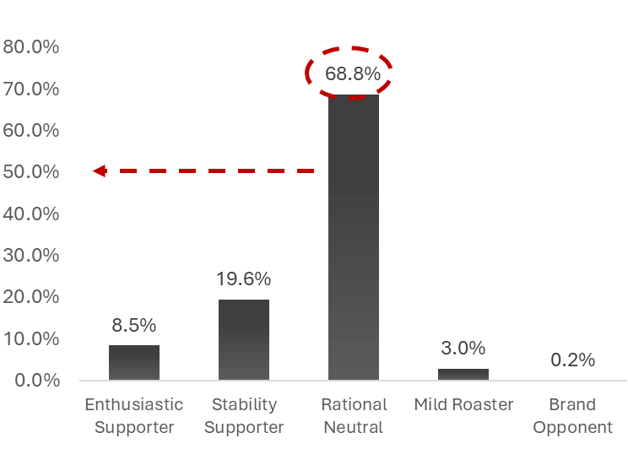
GROUP 5
GROUP 5
Brand Introduction
Buyer Analysis
Conclusion
Notes:
Although the college student demographic represents a market with enormous potential, a substantial proportion of users within this group maintain neutral or negative attitudes. Those with neutral or negative emotional attitudes account for over 70%. We plan to conduct research to understand why this segment holds negative attitudes and develop targeted marketing strategies accordingly. This approach will be detailed in subsequent presentations.

Slide 17
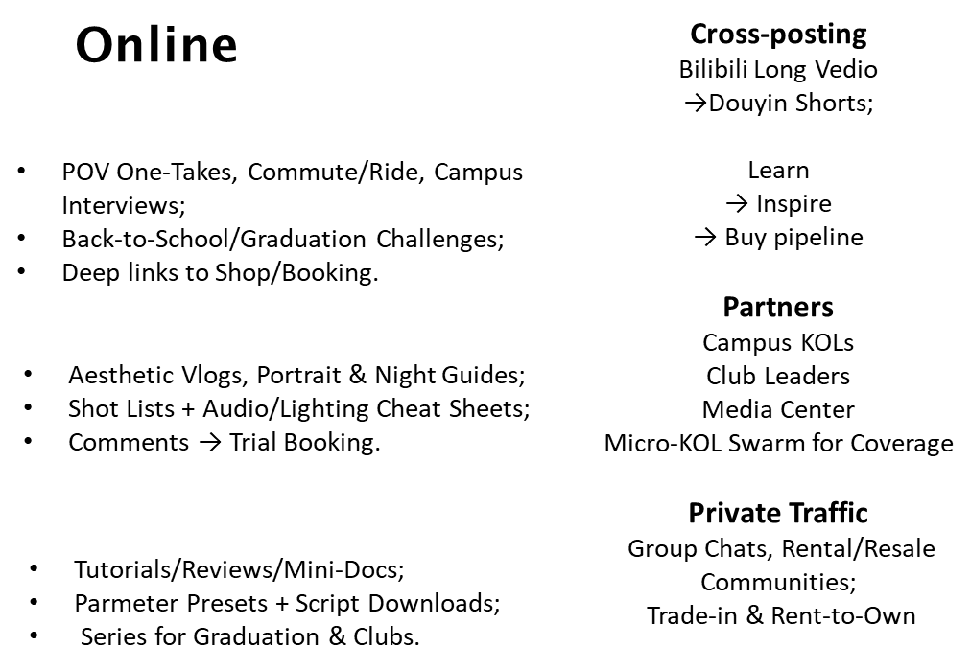



GROUP 5
Brand Introduction
Buyer Analysis
Conclusion
WHERE
Notes:
P1 — WHERE (Digital)
Douyin: POV one-takes, commute/ride, campus interviews; Back-to-School/Graduation Challenges; deep links to shop/booking
RED: aesthetic vlogs, portrait & night guides; shot lists + audio/lighting cheat sheets; comments → trial booking
Bilibili: tutorials/reviews/mini-docs; parameter presets + script downloads; series for graduation & clubs
Cross-posting: Bilibili long → Douyin/Video Channels shorts; Learn → Inspire → Buy pipeline
Partners: campus KOLs, club leaders, media center; micro-KOL swarm for coverage
Private traffic: group chats, rental/resale communities; trade-in & rent-to-own

Slide 18
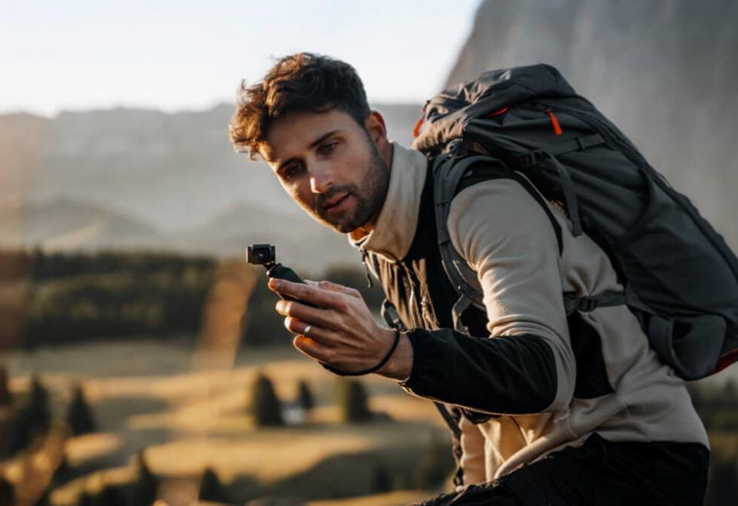
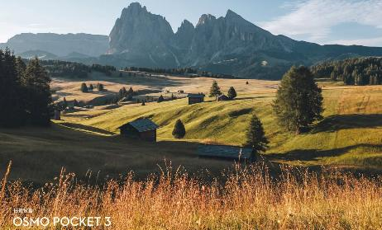
GROUP 5
Brand Introduction
Buyer Analysis
Conclusion
Onsite
Clubs & Events
Photography/Drone/Cycling/Media/Arts with Designated POV Spots;
Official Recap to Lock WOM
Segment Kits
Journalism (Interview Kit), Art/Arch (Portfolio Walk-Through), Eng/Research (Lab Demos), Sports (Race POV), Travel (Citywalk Pack), Freshmen (Rent → Convert)
Workshops
Loaner Units + 15-min Edit Bootcamps (Shooting/Audio/Editing)
Offers & Hooks
Student Bundles, Accessory Coupons, Limited-Time Campus Price, Trade-in, Rent-to-Wwn
Pop-ups/Roadshows
Back-to-School & Graduation Tours;
Shoot-and-Edit Service Booth
3C Stores
“One Device, Three scenes” Guided Demos (Low-Light / Interview / One-Band)
WHERE
Notes:
P2 — WHERE (Offline) + Hooks
Clubs & events: photography/drone/cycling/media/arts with designated POV spots; official recap to lock WOM
Workshops: loaner units + 15-min edit bootcamps (shooting/audio/editing)
Pop-ups/roadshows: back-to-school & graduation tours; shoot-and-edit service booth
3C stores: “one device, three scenes” guided demos (low-light / interview / one-hand)
Segment kits: Journalism (interview kit), Art/Arch (portfolio walk-through), Eng/Research (lab demos), Sports (race POV), Travel (citywalk pack), Freshmen (rent→convert)
Offers & hooks: student bundles, accessory coupons, limited-time campus price, trade-in, rent-to-own

Slide 19
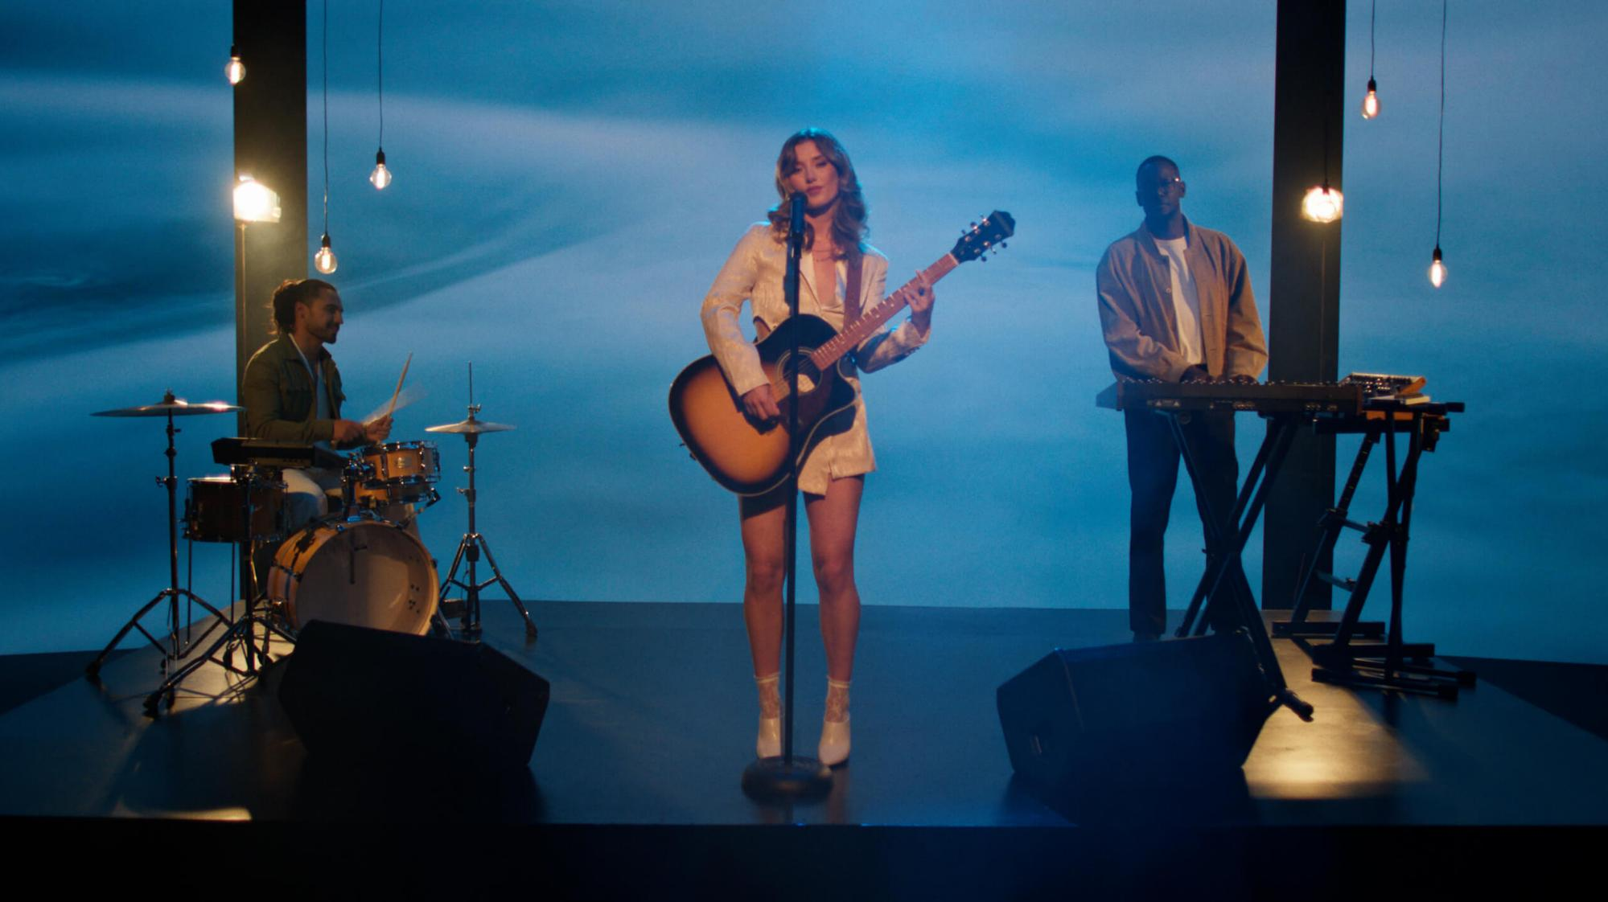
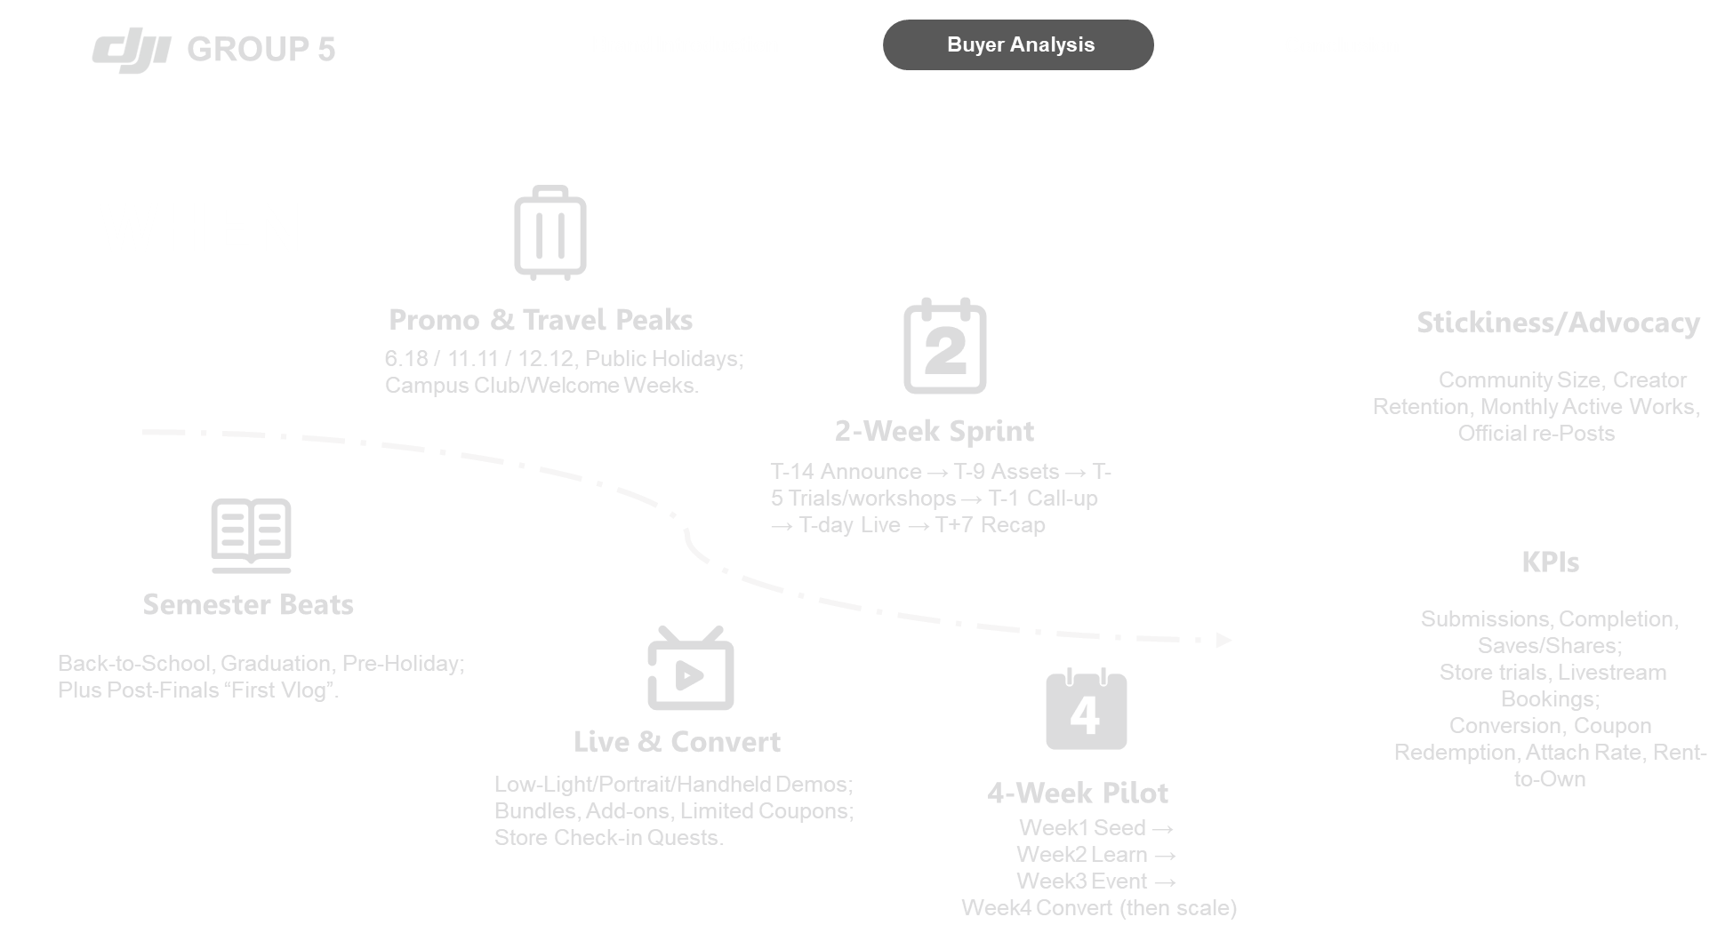
Notes:
P3 — WHEN + Cadence + KPIs
Semester beats: Back-to-School, Graduation, Pre-Holiday; plus post-finals “first vlog”
Promo & travel peaks: 6.18 / 11.11 / 12.12, public holidays; campus Club/Welcome Weeks
Live & convert: low-light/portrait/handheld demos; bundles, add-ons, limited coupons; store check-in quests
2-week sprint: T-14 announce → T-9 assets → T-5 trials/workshops → T-1 call-up → T-day live → T+7 recap
4-week pilot: Week1 Seed → Week2 Learn → Week3 Event → Week4 Convert (then scale)
KPIs: submissions, completion, saves/shares; store trials, livestream bookings; conversion, coupon redemption, attach rate, rent-to-own
Stickiness/advocacy: community size, creator retention, monthly active works, official re-posts

Slide 20
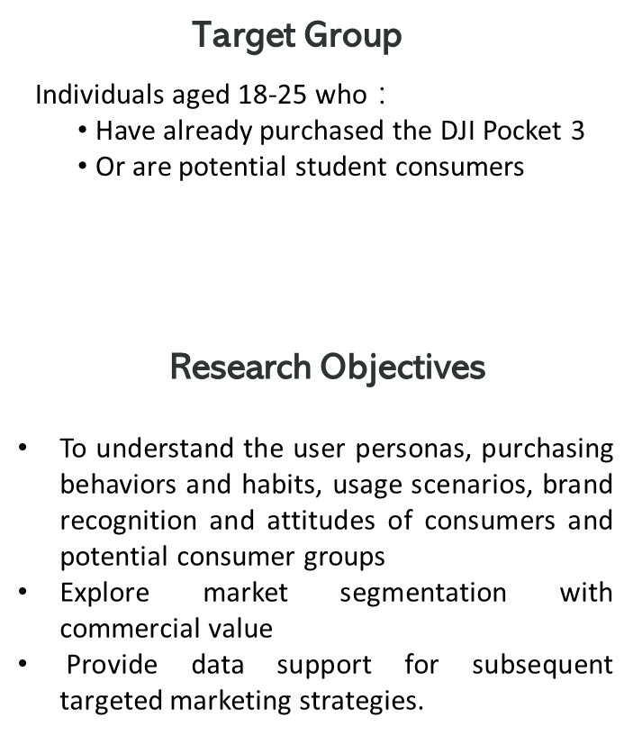

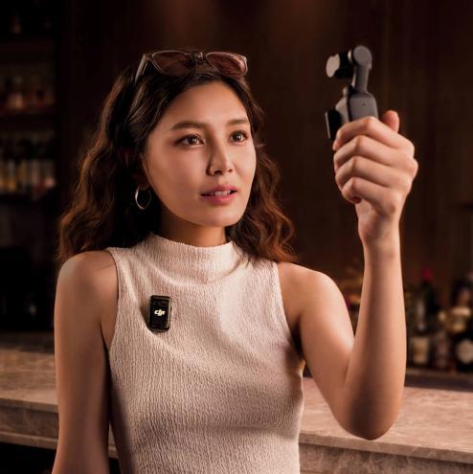
GROUP 5
Brand Introduction
Buyer Analysis
Conclusion
Research Method
——
Questionnaire
HOW
Notes:
Questionnaire Design
The target group for this research is individuals aged 18-25 who have already purchased the DJI Pocket 3 or are potential student consumers.
Research objectives: To understand the user personas, purchasing behaviors and habits, usage scenarios, brand recognition and attitudes of consumers and potential consumer groups, explore market segmentation with commercial value, and provide data support for subsequent targeted marketing strategies.

Slide 21
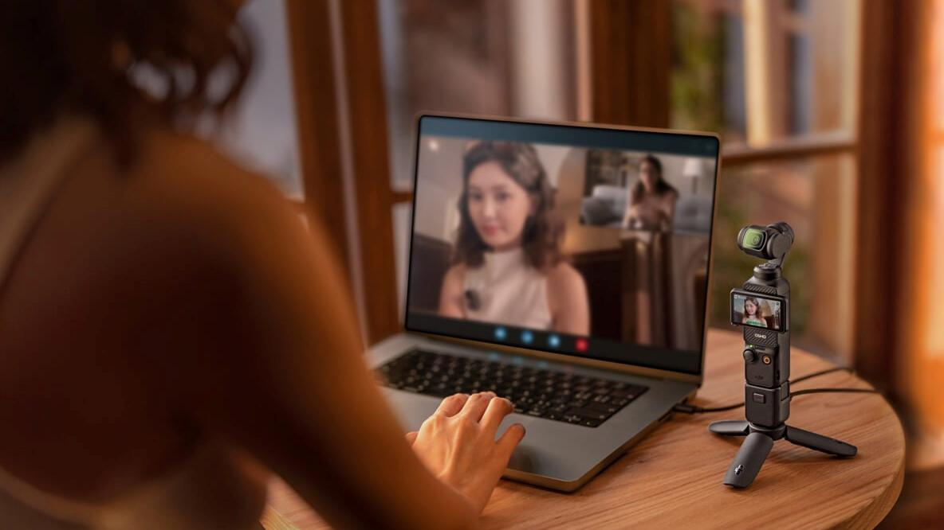

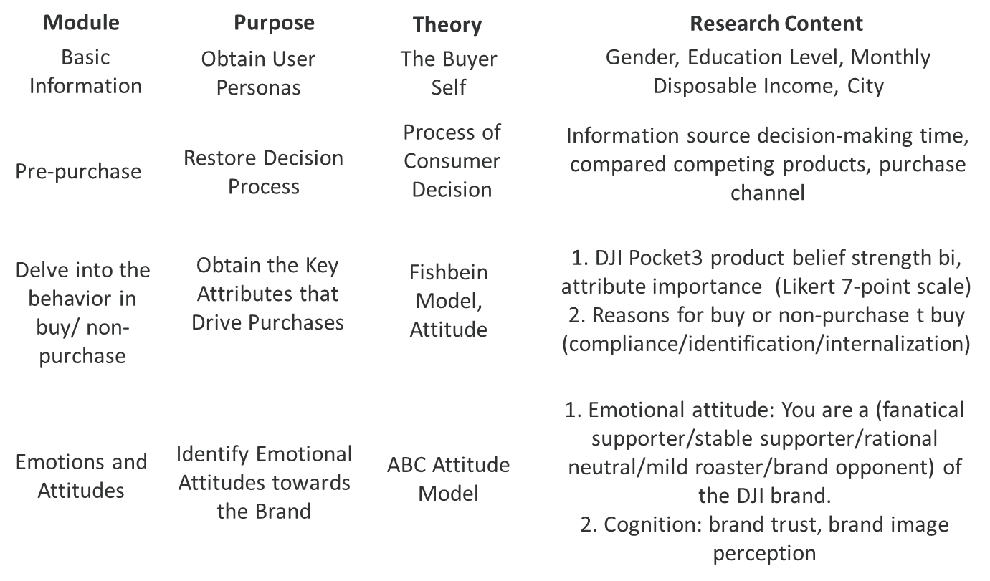
GROUP 5
Brand Introduction
Buyer Analysis
Conclusion
Research Method
——
Questionnaire
Design
HOW

Slide 22
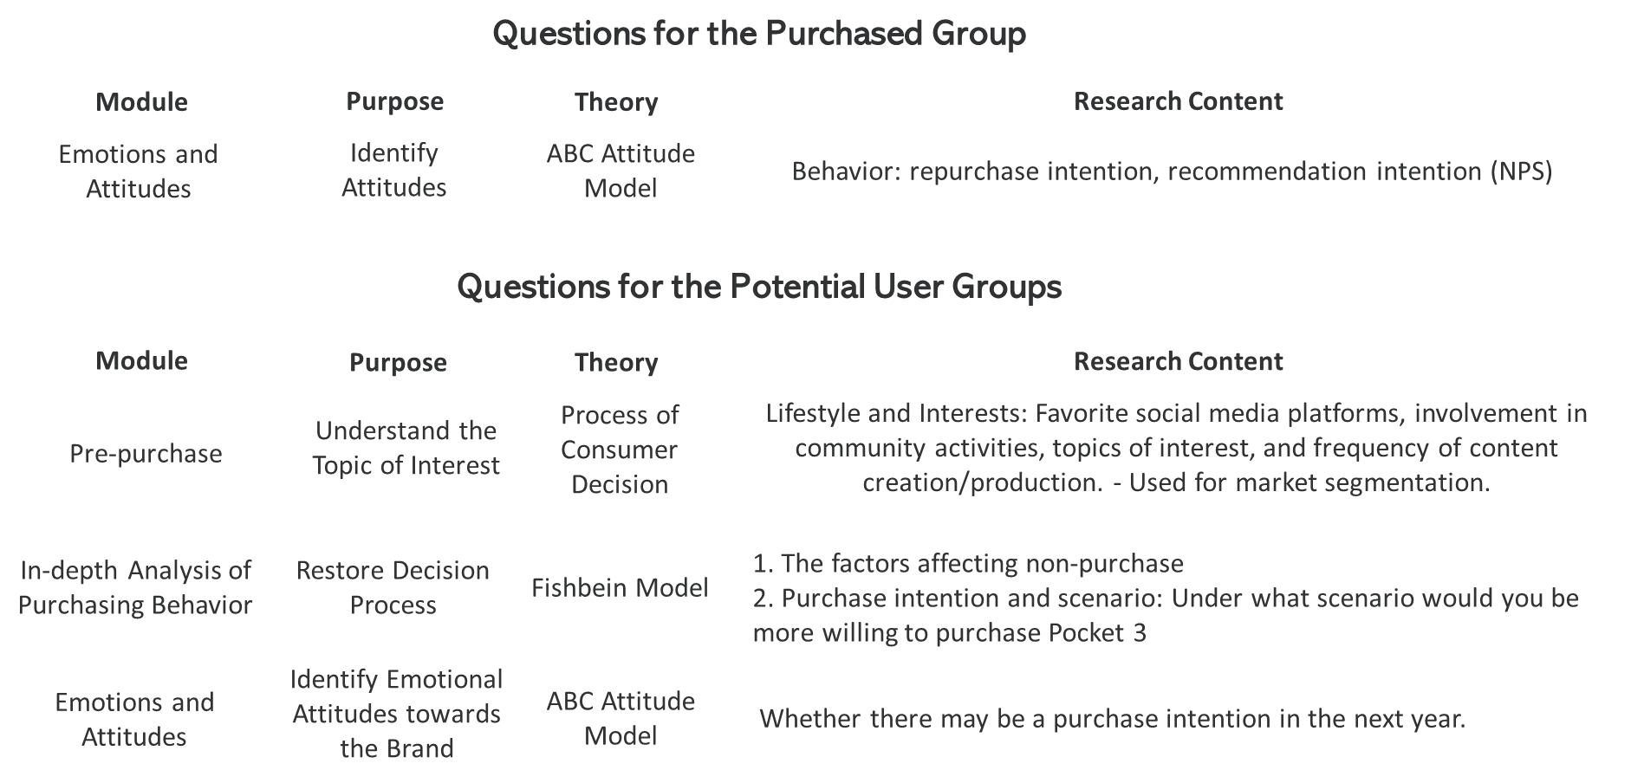
GROUP 5
Brand Introduction
Buyer Analysis
Conclusion

Slide 23




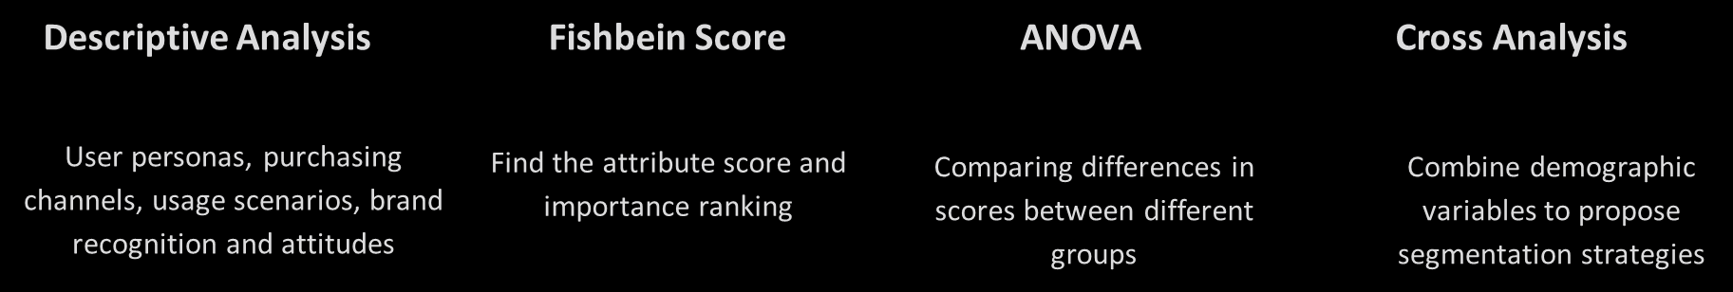
GROUP 5
Brand Introduction
Buyer Analysis
Conclusion
Statistical Analysis

Slide 24

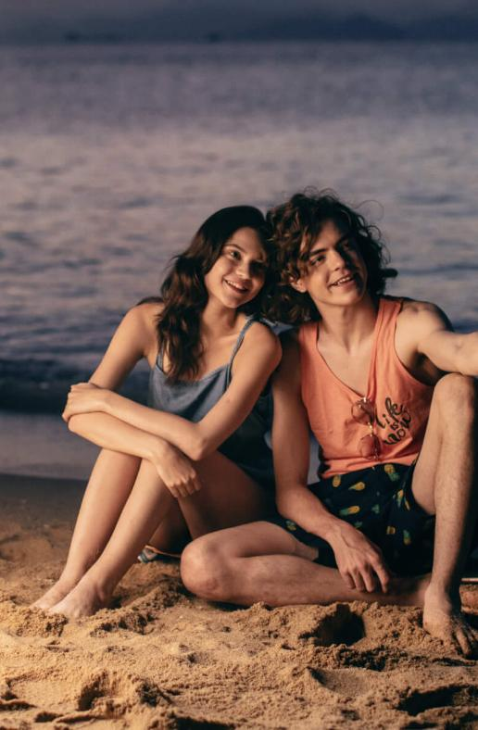
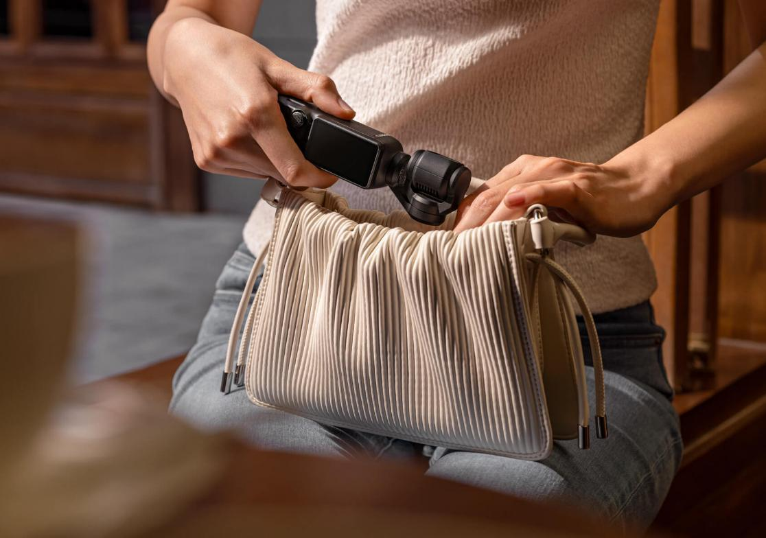
GROUP 5
Brand Introduction
5W1H Analysis
Conclusion
NEXT PART >>
Conclusion
Brand Introduction
5W1H Analysis

Slide 25
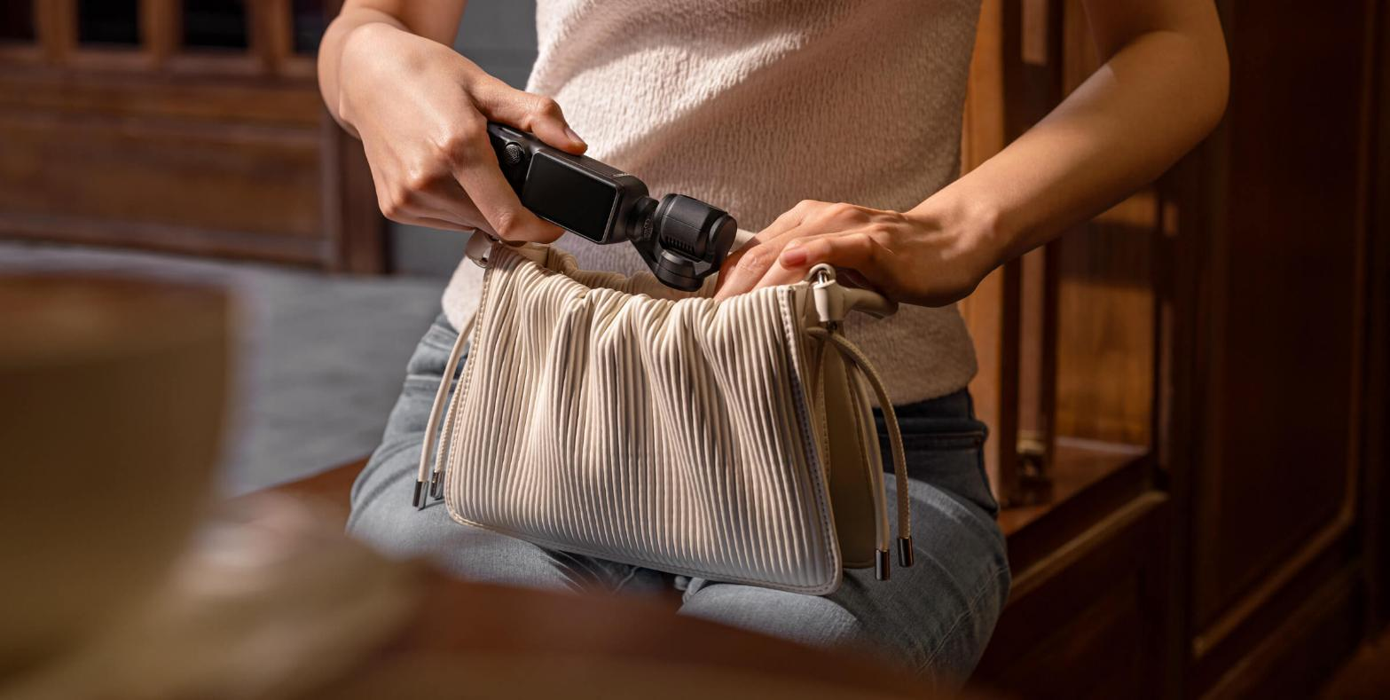
GROUP 5
Brand Introduction
5W1H Analysis
Conclusion
Conclusion
Brand Introduction
5W1H Analysis

Slide 26
GROUP 5
Brand Introduction
Buyer Analysis
Conclusion
THANK YOU >>

